Slide 1
Signaling sarcasm: From hyperbole to hashtag
Florian Kunneman, Christine Liebrecht, Margot van Mulken, Antal van den Bosch

Slide 2
Introduction
Sarcasm appears to be a commonly recognized concept by many Twitter users, who explicitly mark their sarcastic messages by using hashtags such as ‘#sarcasm’ or ‘#not’.
By using the explicit hashtag any remaining doubt a reader may have is taken away: the message is not to be taken literally; it is sarcastic.
A clear advantage of this approach is the easy acquisition of a vast amount of training data. On the other hand, its performance is dependent on the correctness of two assumptions:
1) users who include one of the selected hashtags in their tweet actually intended to convey sarcasm and indeed intended to flip the polarity of the message
2) the pattern of sarcasm in a tweet still holds when the hashtag is excluded from it as a training label.

Slide 3
Contribution
A sarcasm classifier is trained on several markers(hashtags) of sarcasm in tandem (联合)
performance is assessed on a realistically large and unbiased sample of tweets.
We provide insight into the role of hyperbole(夸张法) in sarcastic tweets

Slide 4
Experimental setup
Hashtag selection
We also found empirical evidence that we need to expand the set of hashtags.
Liebrecht, Kunneman, and Van den Bosch (2013) reported that training a classifier solely on ‘#sarcasm’ as a training label resulted in high weights for hashtags that have the same function as ‘#sarcasm’
We decided to extract all hashtags from the ranked list of features from the (Liebrecht et al., 2013) study and manually examine the tweets accompanying them by means of twitter.com.
We selected the hashtags that almost unambiguously denoted sarcasm in a tweet: ‘#sarcasm’, ‘#irony’, ‘#cynicism’, ‘#not’

Slide 5
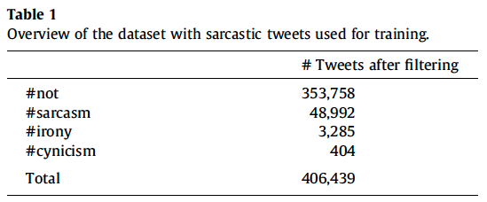
Experimental setup
Data collection: Training
Sarcastic
A database provided by the Netherlands e-Science Centre consisting of IDs of a substantial portion of all Dutch tweets posted from December 2010 onwards (Tjong Kim Sang & Van den Bosch, 2013)
Collected all tweets that contained the Dutch versions of the selected hashtags ‘#sarcasm’, ‘#irony’, ‘#cynicism’, and ‘#not’ until January 31st 2013.
This resulted in a set of 644,057 tweets
Cleaned up the dataset by only including tweets in which the given hashtag was placed at the end or exclusively followed by other hashtags or a url
Following Mohammad (2012) and González-Ibánez et al. (2011),
Hashtags placed somewhere in the middle of a tweet are more likely to be a grammatical part of the sentence than a label (Davidov et al., 2010b
Discarded re-tweets (re-postings of an earlier tweet by someone else).
resulted in 406,439 tweets in total as training data
Background
took a sample of tweets in the period from October 2011 until September 2012
not containing tweets with any of the sarcastic hashtags
Discarded re-tweets (re-postings of an earlier tweet by someone else).
406,439 tweets were selected randomly

Slide 6
Experimental setup
Data collection: Test
a large sample of tweets posted on a single day outside the time frame from which the training set is collected
namely February 1, 2013
Discarded re-tweets (re-postings of an earlier tweet by someone else).
this set of tweets contains approximately 2.25 million(百万) tweets
353 carry one of the sarcasm hashtags at the end

Slide 7
Experimental setup
Preprocessing
Punctuation, emoticons, and capitalization information were kept
as these may be used to signal sarcasm (Burgers et al., 2012b)
made use of word uni-, bi- and trigrams as features (including punctuation and emoticons as separate words)
user names and URLs were normalized to ‘USER’ and ‘URL’ respectively
removed features containing one of the hashtags from the training set
removed terms that occurred three times or less or in two tweets or less
Classification
Balanced Winnow (Littlestone, 1988) as implemented in the Linguistic Classification System
http://www.phasar.cs.ru.nl/LCS/
assign per-instance scores to each label
which can be seen as its confidence in that label
This algorithm is known to offer state-of-the-art results in text classification, and produces interpretable per-class weights
that can be used to, for example, inspect the highest-ranking features for one class label.
The a and b parameters were set to 1.05 and 0.95 respectively.
The major threshold (h.) and the minor threshold (h) were set to 2.5 and 0.5.
The number of iterations was bounded to a maximum of three.

Slide 8
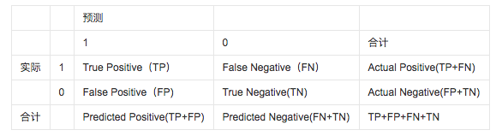
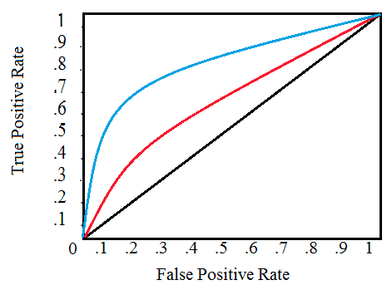
Experimental setup
The first evaluation
focuses on the 353 tweets in the test set ending with one of the selected sarcasm-hashtags among 2.25 million other non-sarcastic tweets
We measured how well these tweets were identified using
true positive rate (TPR, 真正率) = TP / (TP + FN)
false positive rate (FPR, 假正率) = FP / (FP + TN)
the area under the curve (AUC)
that is argued to be more resistant to skew than F-score, due to relying on FPR rather than precision (Fawcett, 2004).
The second evaluation
we manually inspect the test tweets identified by the classifier as sarcastic
but that do not carry any of the sarcastic hashtags
While they would be labeled as false positives in the first evaluation, the absence of one of these hashtags does not necessarily imply the tweet is non-sarcastic.
We rank its predictions by the classifier’s confidence on the ‘sarcasm’ label and inspect manually which of the top-ranking tweets is indeed sarcastic.

Slide 9
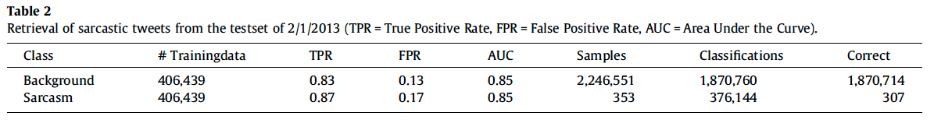
Evaluation - 1

Slide 10
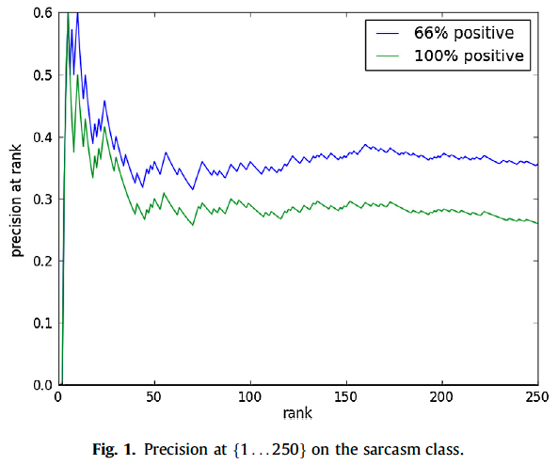
Evaluation – 2
We generated a list of the 250 most confident ‘sarcasm’-labeled tweets
Three annotators judged these tweets as being either sarcastic or not.
In case of doubt, for example due to the lack of context, a tweet should be annotated as non-sarcastic
When taking the majority vote of the three annotators as the golden label, a curve of the precision at all points in the ranking can be plotted

Slide 11
Analysis
Reliability of the training set
The three annotators coded a random sample of 250 tweets with sarcastic hashtags from the training set. The tweets were sampled proportional to the percentage of the four hashtags in the training set
162 ‘#not’-tweets
86 ‘#sarcasm’-tweets
2 ‘#irony’-tweets
212 of the 250 annotated sarcastic tweets, about 90%, were found to be sarcastic
Using hashtags as golden labels thus introduces about 10% noise into the labeled training data
Of these tweets, 85% were judged as being actually sarcastic.

Slide 12
Analysis
Four types of words that constitute the top-500 of most predictive features
The list of strongest predictors shows that some intensifiers(增强词) are indeed strong predictors of sarcasm
such as (with and without capitals) geweldig (awesome), heerlijk (lovely), prachtig (wonderful), boeiend (fascinating), allerleukste (most fun), perfect, and super.
Many unintensified positive adverbs and adjectives occur in the list of strongest predictors as well
such as interessant (interesting), gezellig (cozy), leuk (fun), handig (handy), slim (smart), charmant (charming) and nuttig (useful). Considerably less negative words occur as strong predictors
Substantial set of positive exclamations(感叹词) are found by the classifier as strong predictors
Non-sarcastic hashtags that signal meta-communication
such as ‘#humor’, ‘#lml’ (love my life), ‘#wehebbenerzinin’ (we are looking forward to it), ‘#gaatgoed’ (all is well), ‘#bedankt’ (thanks), and ‘#grapje’ (joke).

Slide 13
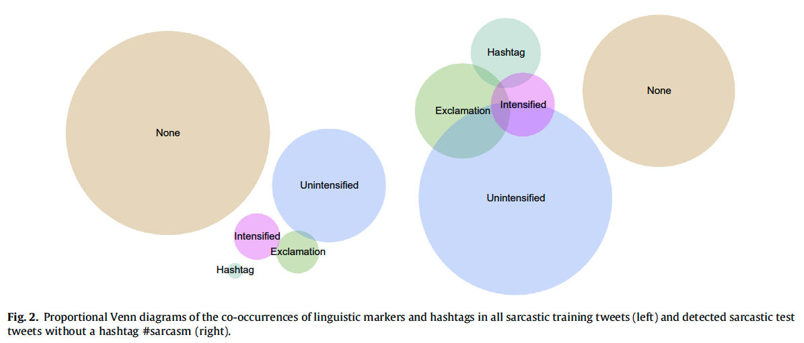
Analysis

